Slide 1
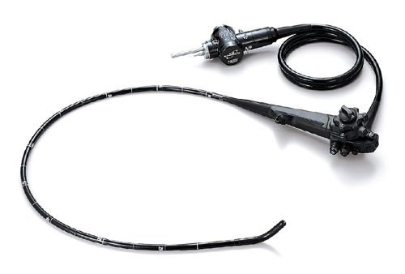
Flexible Endoscopic Robot
Submitted by:
Kshitij Gupta 2016ME0760
Shantnav Agarwal 2016ME20767
Supervisor:
Prof. Jitendra Prasad Khatait

Slide 2

Introduction
Endoscopy: Probing organs difficult to image
Soft Robotics for maneuverability and controllability
Modelling and simulations for further development and training purposes

Slide 3
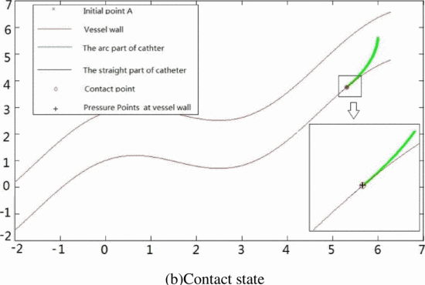
Literature Survey
Friction resistance models based on Hertzian model have been developed for some types of endoscopes
Research in the simulation of catheters using continuum body approach
Insertion of a flexible instrument in a tube modelled as Bezier curve in SPACAR using sliding contact has been done
Attempts made to do the simulation of looping phenomenon in software like LS-DYNA

Slide 4
Objectives
Simulate the navigation of a flexible endoscope inside a human colon
Model the endoscope and intestine using finite elements
Observe the forces and deformation to ascertain the range of suitable material properties
Develop dynamic force fields

Slide 5
Methodology
FE Modelling
Model the endoscope as well as the human large intestine as a combination of beam elements
Dynamic Force Fields
Simulated a simple model to ensure behaviour of the model of large intestine is like real life.
Carrying out Simulations in SPACAR
Computationally efficient and allows for detailed visualization
Multiple force fields used to model contact force between the endoscope and large intestine.
Force from these fields lead to deformations. Thus at each time step, the shape of force fields changes with the change in shape of large intestine.
Calculates the maximum forces applied, stresses at each time step

Slide 6
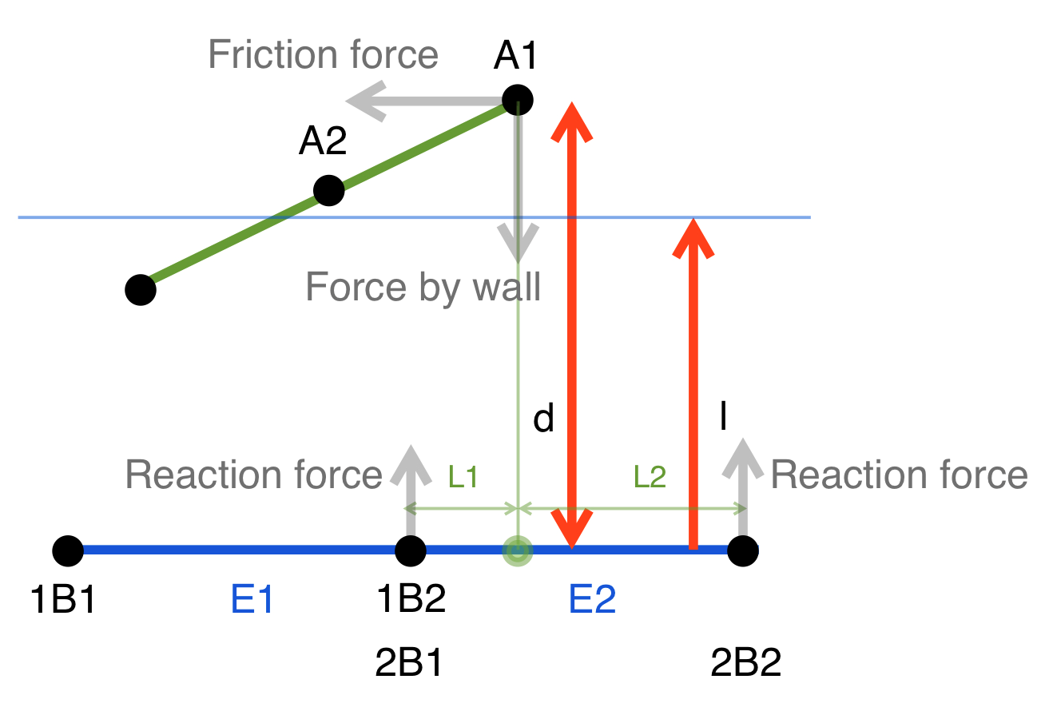
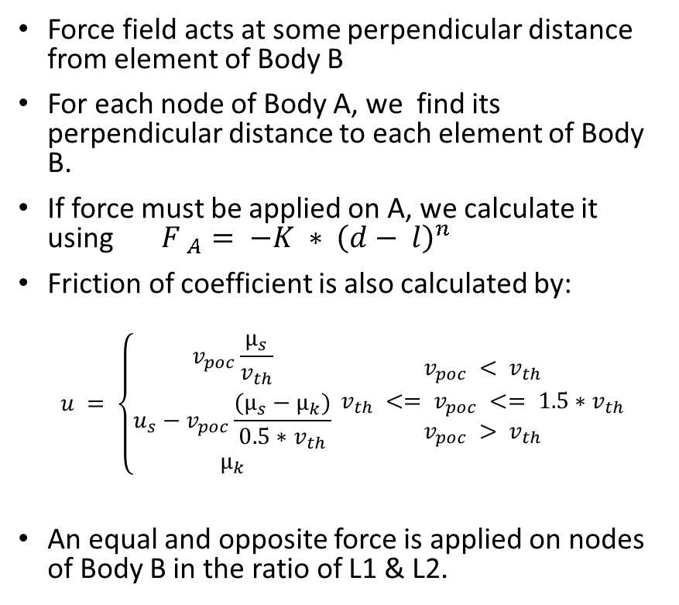
Developing dynamic force fields
Force field acts at some perpendicular distance from element of Body B
For each node of Body A, we find its perpendicular distance to each element of Body B.
If force must be applied on A, we calculate it using ${F }_{A}= −K ∗ {\left(d− l\right)}^{n}$
Friction of coefficient is also calculated by:
$$u = \left\{\begin{aligned}v_{poc}\frac{µ_{s}}{v_{th}} \\ u_{s}−v_{poc}\frac{(µ_{s}−µ_{k})}{0.5∗v_{th}} \\ µ_{k}\end{aligned}\right. \begin{matrix}v_{poc} < v_{th} \\ v_{th} <= v_{poc} <= {1.5∗v}_{th} \\ v_{poc} > v_{th}\end{matrix}$$
An equal and opposite force is applied on nodes of Body B in the ratio of L1 & L2.

Slide 7
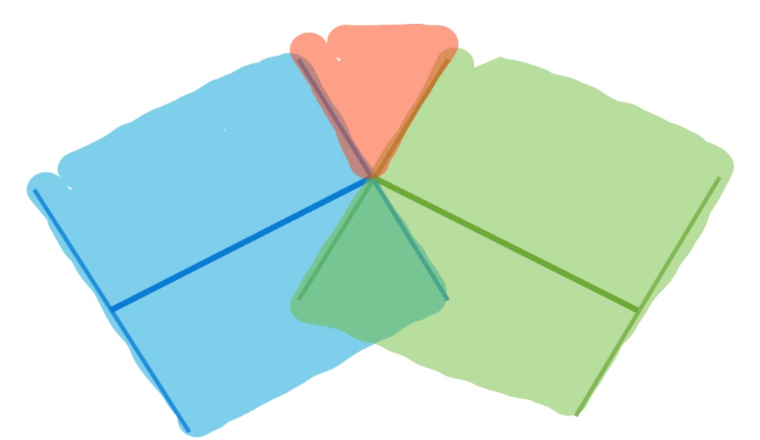
Nodal interactions
For corner cases, such as nodes lying in orange region, we calculate distance from the nearest node
For nodes, which do not lie within 2*l distance, we choose the element or node in its vicinity to apply forces

Slide 8
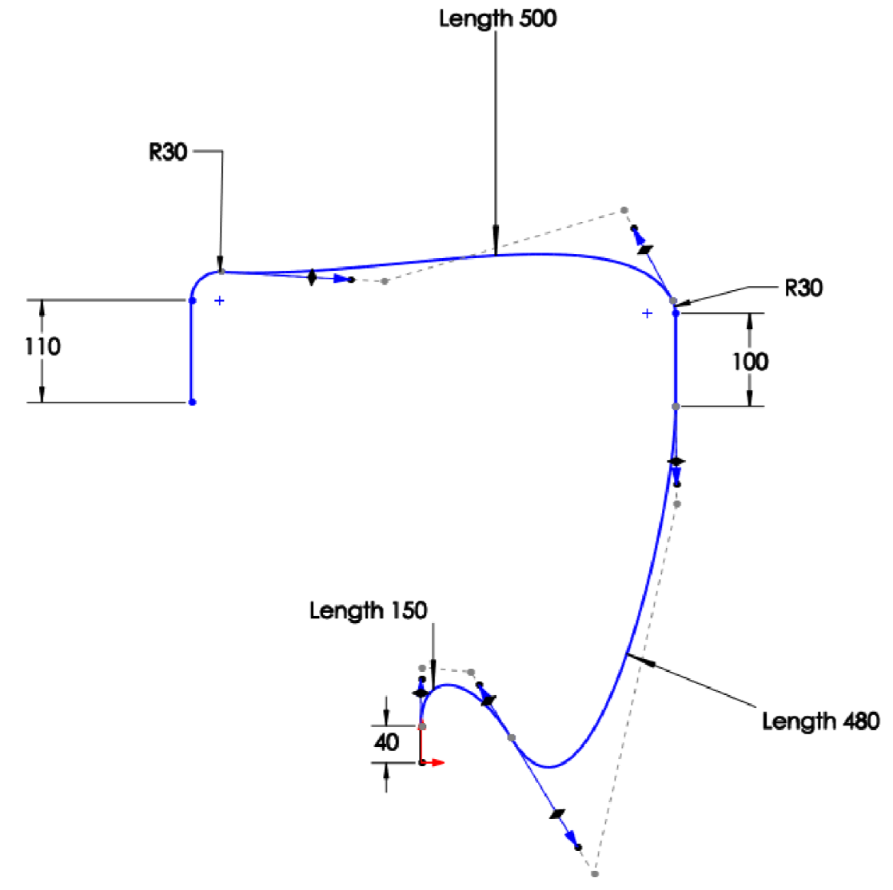
Colon model
Developed colon model based on the size of the average adult human
Used 23 beam elements to model the colon.

Slide 9
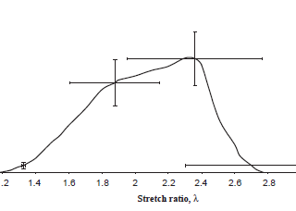
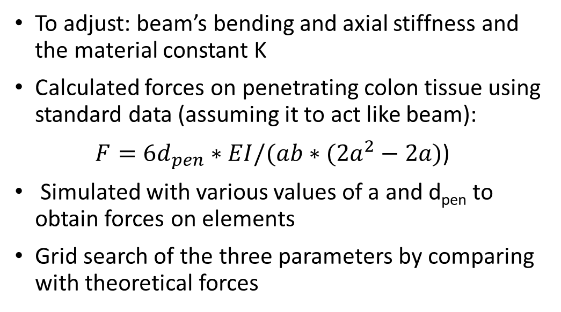
Adjusting model parameters
To adjust: beam’s bending and axial stiffness and the material constant K
Calculated forces on penetrating colon tissue using standard data (assuming it to act like beam):
$F=6d_{pen}∗EI/(ab∗(2a^{2}−2a)$)
Simulated with various values of a and d_{pen} to obtain forces on elements
Grid search of the three parameters by comparing with theoretical forces

Slide 10
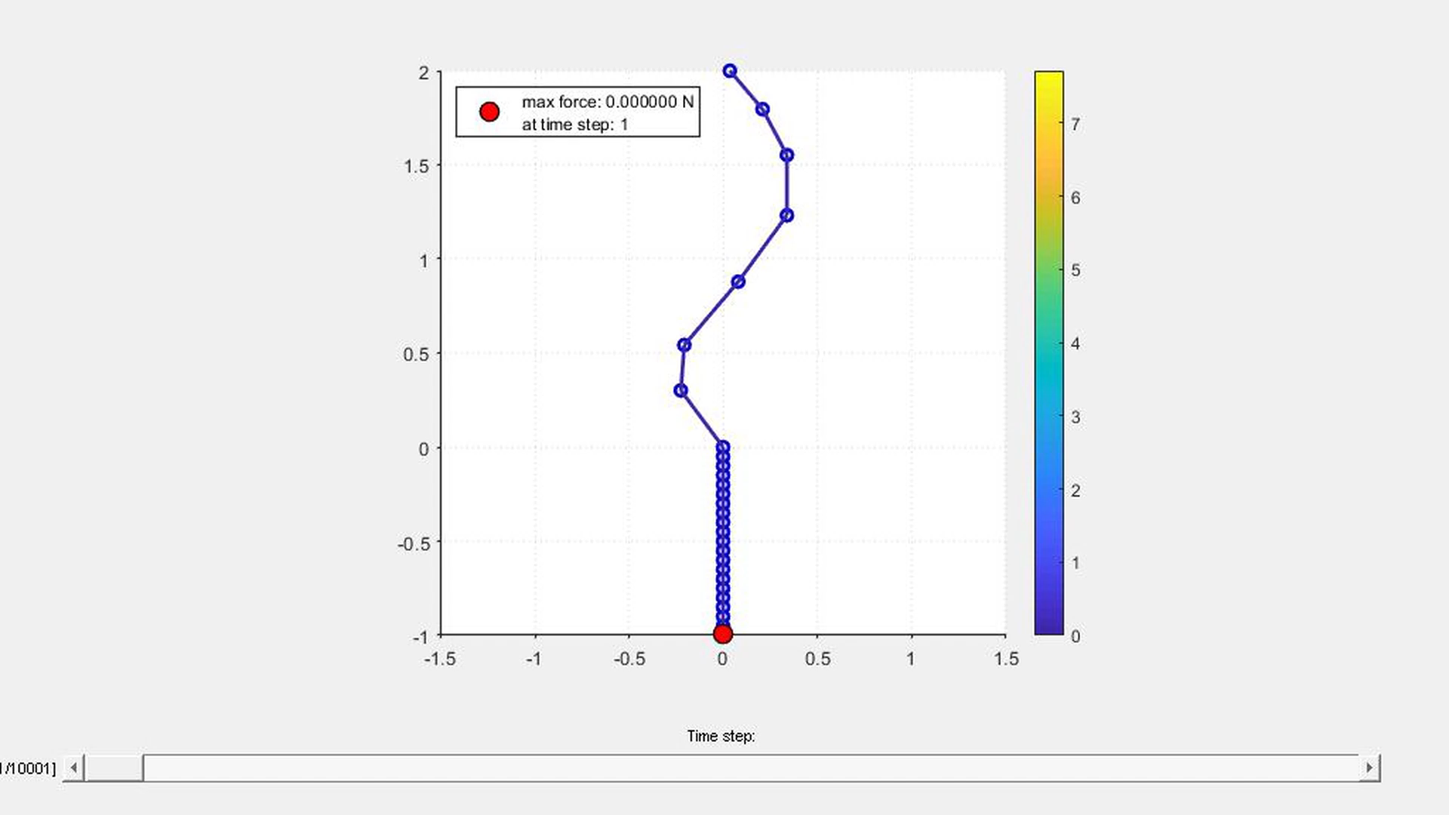
Simulation 1 – Bezier curve

Slide 11
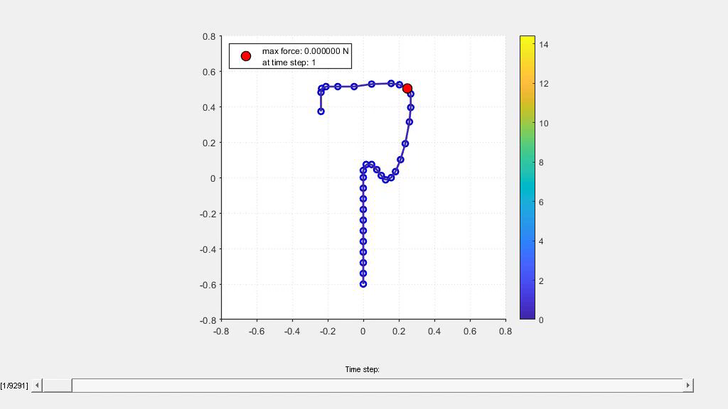
Simulation 2 – Large Intestine

Slide 12
Simulation Parameters
Type of Elements | Planar Beam
Number of Elements | 23
Length | 1.38 m
Mass per unit length | 0.08532 kg/m
Rotational Inertia J | 0.00008393 kg-m²
Axial Stiffness (EA) | 500 N/m
Bending Stiffness (EI) | 0.0025 N/m
Longitudinal Damping | 0.000001 N-s/m
Bending Damping | 0.00001 N-s/m
Inner Diameter | 30 mm
Thickness | 2 mm
Friction Coefficient | 0.4
Our simulation worked well for these (colon) beam parameters:

Slide 13

Features and Conclusions
Our model can be used to model interaction of a body inside a tube:
We have made a framework where the parameters of the beam elements can be tuned to mimic behavior of the tube in real life
The user can easily enter coordinates of a tube along which the instrument has to move and model much more complex scenarios

Slide 14
Thank you

